Slide 1

Corporatica Backend
Advanced Data Processing and Analysis Application
Presented by: [Abdelrhman Saeed]

Slide 2
Project Overview
Advanced software application focused on containerization and deployment technologies
In-depth analysis and manipulation of various data types
Robust back-end developed in Python using Flask

Slide 3
Planning and Design
Initial planning stages and brainstorming sessions
Design considerations: scalability, performance, ease of use

Slide 4
Technology Stack
Python 3.11
Flask
SQLAlchemy, PyMongo
PostgreSQL, MongoDB
Docker, Docker Compose
- pandas, numpy, matplotlib, textblob, yake, PIL, cv2

Slide 5
Tabular Data Processing
5
Upload and Process Files
SQL Queries
Advanced Statistics
Explore the capability to upload and process CSV, XLS, XLSX files. Efficiently handle various file formats for data processing.
Perform SQL queries to extract specific data insights. Enhance data processing with SQL capabilities for targeted analysis.
Compute advanced statistics including mean, median, mode, quartiles, and outliers. Gain deeper insights through statistical analysis.

Slide 6
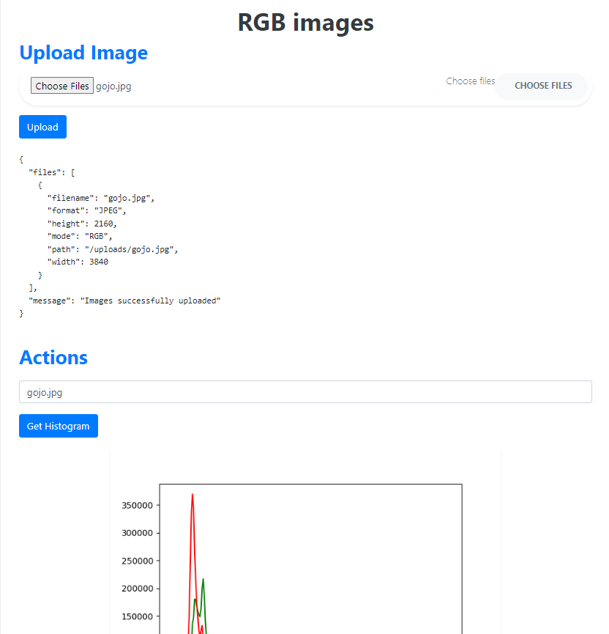
RGB Image Processing
Store and Analyze Images
Image Manipulations
Upload and store images for processing. Generate color histograms and segmentation masks to understand image components.
Perform resizing, cropping, and format conversion on RGB images. Enhance image quality through manipulations.

Slide 7
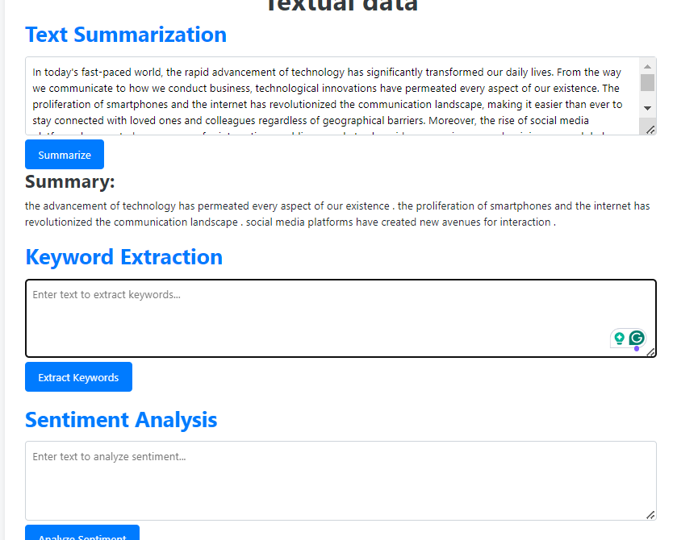
Textual Data Analysis
Text Analysis Techniques
Explore text summarization, keyword extraction, and sentiment analysis methods. Gain insights from textual data through advanced analysis.

Slide 8

Challenges Faced
Data Preprocessing
Overcome challenges in data preprocessing and cleaning. Ensure data quality for accurate analysis.

Slide 9
Technology Choices
Python & Flask | Rapid development and robust backend
PostgreSQL | Relational data management
MongoDB | Document storage
Docker | Containerization and easy deployment

Slide 10

Summary of Achievements
10
Successful Implementations
Highlight the successful implementation of data processing and analysis features. Showcase seamless integration between frontend and backend systems.

Slide 11
Future Work
Additional features and enhancements
Performance optimization
User feedback integration

Slide 12

ANY Questions ?

Slide 13

Contact Details
GitHub : https://github.com/Samspei01
Email : abdosaaed749@gmail.com

Slide 14

Thank You

